Slide 1

Movie Revenue
Prepared by gilbert Hernandez

Slide 2
Overview
Impact of Movie success
Hypotheses
General Data
Statistical Process
Analysis
Bonus
Findings & Recommendations
Sources

Slide 3
Impact of Movie Success
Business success is often defined as revenue.
What is the specific effect of budget to determine success?
“The more you put in the more you get out.”
Summer is known as the “vacation season”. Does it have an impact on movie success?

Slide 4
Hypotheses
Analysis 1: Budget and Revenue
Null Hyp 1 (Ho): There is no positive, direct variation between budget and revenue.
Alternate Hyp 1 (Ha): There is a positive, direct variation between budget and revenue.
-----------------------------------------------------------------------------------------------------------------
Analysis 2: Summer Release and Revenue
Null Hyp 2 (Ho): Movies released in the summer months have no impact on revenue.
Alternate Hyp 2 (Ha): Movies released in the summer months have an impact on revenue.

Slide 5
Data Set
Data is provided by Kaggle.com, “Movie Dataset: Budgets, Genres, Insights”
Budget & Revenue are integers
Release Date is in year-month-day
Total of 4802 listed movies from 1916 to 2017
Budget range: $0 – 380,000,000
Revenue range: $0 – 2,787,965,087
Only movies released in 2011 and newer are used.
Drop all movies whose budget or revenue are 0.
Total of 785 usable movie data
Budget range: $10 - 380,000,000
Revenue range: $11 – 1,519,557,910

Slide 6
Statistical Process
Analysis 1: Budget & Revenue
Create a scatterplot to see the relationship of these values
Calculate the correlation coefficient to determine how strong a line of best fit
Calculate the p-value to determine if null hyp is rejected (< 0.05)
Analysis 2: Summer release & Revenue
Create a box plot to see comparison of distribution
Calculate the p-value using the Mann-Whitney test

Slide 7
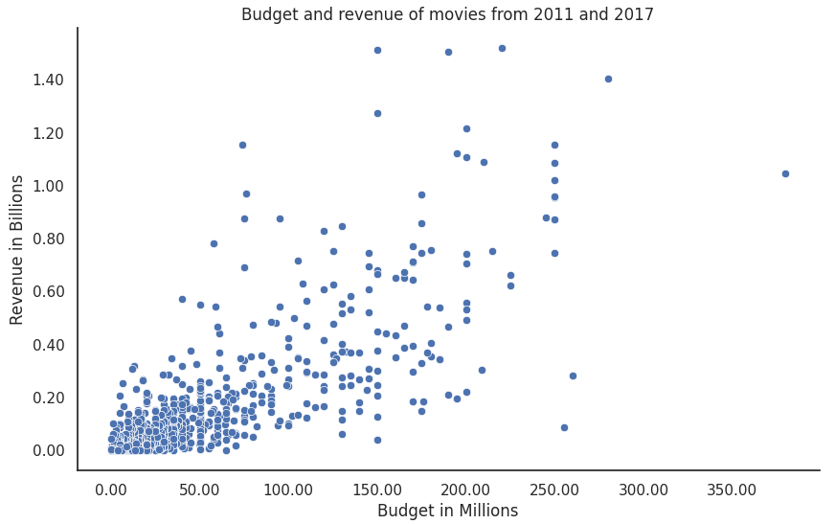
Analysis 1: Budget & Revenue
Significant data
509 movies under $50M budget (65%)
Average revenue $163.5 million
Correlation coefficient 0.778
P-value
1.63e -160 < 0.05
Reject null hypothesis of no positive correlation
There IS statistical evidence that the budget has a positive correlation with revenue.

Slide 8
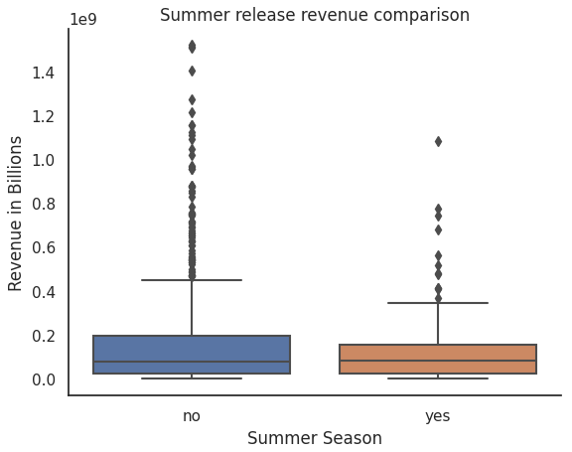
Analysis 2: Summer Movie & Revenue
Significant data
133 summer movies (17%)
652 non-summer
Average revenue
Summer: $194.2 million
Non-summer: $153.3 million
P-value 0.513 > 0.05
Failed to reject the null hypothesis of no difference in summer release
There IS NO statistical evidence that releasing a movie in summer will result in higher revenue.

Slide 9
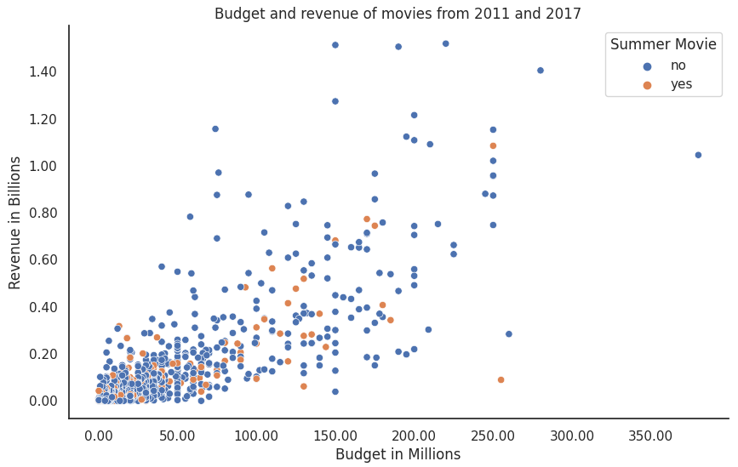
Bonus: Budget, Revenue & Summer Releases
Correlation coefficient
summer movies: 0.78
Non-summer: 0.78

Slide 10
Findings & Recommendation
There is a positive correlation between budget and revenue and there exists evidence of significant statistical relationship between budget and revenue.
Even though there is a moderate correlation strength, it does not signify a direct variation of growth.
More money in budget does not equate to higher revenue.
Movies released in the summer season has no direct effect on revenue.
More analysis is needed to determine if there is a season with a significant effect on revenue.

Slide 11
Sources
(n.d.). Movie Dataset: Budgets, Genres, Insights. Kaggle.com. Retrieved July 18, 2023, from https://www.kaggle.com/datasets/utkarshx27/movies-dataset
(n.d.). Seasons of the Year in the United States. Calendarr.com. Retrieved July 18, 2023, from https://www.calendarr.com/united-states/seasons-of-the-year-in-the-united-states/

